Slide 1
Family Support Provider
Basic Training
Day 1

Slide 2

Session 1
Welcome/Overview and Issues that Impact Families

Slide 3

Welcome!
State your name;
Where are you from?
What is your role?
One thing you would like us to know about you

Slide 4
Housekeeping!
Each session is a hour; followed by a 15 minute break
Lunch is 1 hour long and will be provided to you; if you have any dietary needs, please let us know
Please take lots of notes and ask questions!
Sign in each morning and afternoon
You are not allowed to miss more than 2 hours of the training. Sleeping, lack of participation, or otherwise being distracted will not be counted as participation and you may be asked to leave the training. If you are dismissed from the training—refunds will NOT be issued by the Missouri Credentialing Board.
Be on time
Bathroom breaks and in case of emergency—please discuss

Slide 5
Resiliency
Increasing Protective Factors
Help families stick together
Having connections to family, community and services
Having the ability to remain hopeful and optimistic and feel safe
Reducing Rick Factors
Clinical and focus on reducing risk factors
FSPs support clinical staff in increasing protective factors
Two distinct roles…1 positive outcome of resiliency

Slide 6

Important Points
FSP work has evolved over time naturally
It is complex yet rewarding work
Our FSP training will build a foundation for your work
FSPs work with clinical teams to support families toward goals
FSPs do non-clinical pieces, walk with families
Each CMHC is invited to include FSP services
Supervisors attend to clearly understand FSP roles and value

Slide 7

Quick Summary of Family Support Providers Roles
Strength based
Family driven
Acceptance and belonging
Empowerment and hopefulness
Not a clinical service
Use real life as support lessons
Common lived experience
Not about any diagnosis
Explore possibilities!

Slide 8

Discussions!
Let’s talk about some things!
Provider Qualifications
Key Service Functions
Possible Key Factors impacting your work

Slide 9

Three Possible Factors that Impact the Work You Do with Parents and Caregivers
Poverty
Trauma
Parents/Caregivers with Mental Health and/or Substance Use Disorders

Slide 10
Review Questions: Session 1
What is the role of the Family Support Provider and Community Specialist that supports building family resiliency?
What is a Family Support Provider
What is a Community Support Specialist
What are some examples of the key area of focus of the Family Support Provider in supporting the parent/caregiver in building resiliency?
What are 3 factors that impact the work you do with family members and caregivers?

Slide 11

Session 2
Five Stages of the Building Resiliency Process: Overview

Slide 12
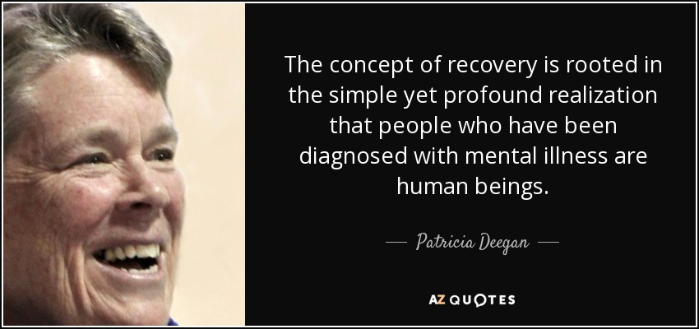
Patricia Deegan Story
Impact of the Behavior and Diagnosis Overwhelmed by

Slide 13
Impact of Behavior/Diagnosis
Poverty
Trauma
Parents/Caregivers with Mental Health and/or Substance Use Disorders

Slide 14

Five Stages in the Building Resiliency Process
Future for child/family is Limited
Given Into
There are times in a family’s life when they…
Change is Possible
Questioning
Impact of the Behavior and Diagnosis Overwhelmed by
The Devastating Power of the child’s behavior, emotional or mental health issues
Symptoms
Stigma
Parent Blame
Actions for Change
Moving Beyond
Commitment to Change

Slide 15
Five Stages in the Building Resiliency Process
Impact of the Behavior and Diagnosis Overwhelmed by

Slide 16
Review Questions: Session 2
1. What are five ways parents often relate to the devastating power of their child/youths emotional, behavioral and mental health issues called “five stages in the building resiliency process”?
a) Impact of Behavior and/or Diagnosis: There are times in a family’s life when they are ____________ by the devastating power of the child’s behavior, emotional or mental health issues.
b) Future for child/family is limited: There are times in a family’s life when they have _____________ the devastating power of the child’s behavior, emotional or mental health issues.
c) Change Is Possible: There are times in a family’s life when they are ______________ the devastating power of the child’s behavior, emotional or mental health issues.
d) Commitment to Change: There are times in a family’s life when they are _________________the devastating power of the child’s behavior, emotional or mental health issues.
e) Actions for Change: There are times in a family’s life when they are __________________ the devastating power of the child’s behavior, emotional or mental health issues.

Slide 17

Session 3
Five Stages in the Building Resiliency Process: Dangers

Slide 18

Five Stages in the Building Resiliency Process: Dangers
At each stage of the building resiliency process there are dangers. At each stage there is a major question that a parent must answer or a major decision that the parent must make. As parents, we always have things influencing our decisions. Internally, there are pressures on the parent to answer this question in a negative way. Externally, there are pressures on the individual to answer this question in a negative way. When the internal and external come together in ways that reinforce each other, it often causes a person to get stuck or side tracked on the journey.

Slide 19

Impact of Behavior and/or Diagnosis
Impact of Behavior and/or Diagnosis: Question of Identity – How will I define myself, my family, child or youth as a result of their behavior and/or diagnosis?
Internally – the parent experiences sadness, loss, guilt because of their failure as a parent, etc. causing them to question their ability to be a parent
Externally – others see the parent as the reason why the child has behavior issues or the reason why they have a diagnosis, will not be able to function as a parent in the future

Slide 20


Five Stages in the Building Resiliency Process
Future for child/family is Limited
Given Into
There are times in a family’s life when they…
? Of Identity
Change is Possible
Questioning
Impact of the Behavior and Diagnosis Overwhelmed by
The Devastating Power of the child’s behavior, emotional or mental health issues
Symptoms
Stigma
Parent Blame
? Of Responsibility
Actions for Change
Moving Beyond
Commitment to Change
? Of Supports

Slide 21

Future for the child/family is Limited
Future for the child/family is Limited: Question of Possibility – How will I relate to possibilities for my child, youth and family when I have been redefined as a parent of a child or youth with behavior issues and/or a mental health diagnosis?
Internally – the parent sees their child/youth and family being unable to do the things that others do.
Externally – others see the parent as not being able to be the parent needed for a child/youth with behavioral/mental health issues.

Slide 22

Change is Possible
Change is Possible: Question of Risk – How will I relate to the need to take risks if I am going to change?
Internally – the parent is afraid of things getting worse instead of better
Externally – others tell the parent they have made some progress and it’s as good as it’s going to be and not push it

Slide 23

Commitment to Change
Commitment to Change: Question of Support – How will I get the supports that my family, child, youth and I need?
Internally – the parent is facing a new experience, doesn’t know what kind of support they need or what their child/youth needs.
Externally – others don’t believe the parent should attempt to change and they fear others won’t support them

Slide 24

Actions for Change
Actions for Change: Question of Responsibility – Will I be able to take on the necessary responsibilities?
Internally – the parent knows/senses they will have to take on more responsibilities, not sure they can do it
Externally – don’t believe the parent knows what is best for their child and family, will need the system to take care of them

Slide 25

Question of Identity
Question of Identity – How will I define myself as a parent as a result of the behavior and/or diagnosis?
Internally – the parent experiences sadness, loss, guilt because of their failure as a parent, etc. causing them to question their ability to be a parent
Externally – others see the parent as the reason why the child has behavior issues or the reason why they have a diagnosis and will not be able to function as a parent in the future

Slide 26
Review Questions: Session 3
What is the danger in the Impact of Behavior and/or Diagnosis stage? Explain.
What is the danger in the Future of Child/Family is Limited Stage? Explain.
What is the danger in the Change is Possible stage? Explain.
What is the danger in the Commitment to Change stage? Explain
What is the danger in the Action for Change stage? Explain

Slide 27
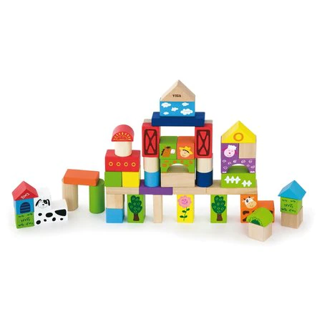
Session 4
Stages of Change Model in Building Resiliency

Slide 28

Stages of Change in Building Resiliency
Become familiar with how clinical professionals understand and discuss stages of change is essential to communicating with clinical teams
Stages of Change Model in Building Resiliency presents commonly understood concepts about stages of change in clinical treatment settings.

Slide 29
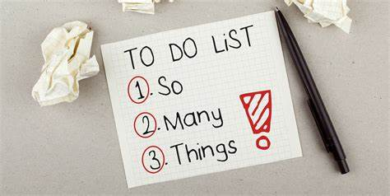
Stages of Change Model in Building Resiliency
The stages of change model is commonly used among clinical staff in treatment programs for behavioral health disorder recovery. The 5 stages of change each have "tasks" that a family needs to achieve before they will move to the next stage. Similar to the 5 stages of recovery, there are skills and tools that can be used in each of the stages that may help a family process the task for that stage and move to the next. Using these tools can help families become ready to make changes in their lives that they were not ready to make before.

Slide 30

Stages of Change Model in Building Resiliency
It is important to understand that the 5 stages of resiliency and the 5 stages of change are two different ways to understand what kind of support a family may need in order to successfully make positive changes in their lives. One approach is not better than the other, and understanding them both can give peers more ways to work with families in the resiliency stage.

Slide 31

Personal Change Experience—Group Activity Part 1
Think about a personal change that you have made in your life
Write everything you can about that experience to share with your group including:
Why—What motivated you to change?
How—What was the process?
When—What was the timeline?

Slide 32

Personal Change Experience—Group Activity Part 2
Think about a personal change that you want to make in your life
Write everything you can about that experience to share with your group including:
Why—What motivated you to change?
How—What was the process?
When—What was the timeline?

Slide 33
Five Stages in the Change Process
Impact of the Behavior and Diagnosis Overwhelmed by

Slide 34
Review Questions: Session 4
What are the five stages of change?
Do all people go through all the stages of change?

Slide 35

Session 5
Using your Resiliency Story as a Resiliency Tool

Slide 36

Using Your Resiliency Story as a Resiliency Tool
One of the major resiliency tools that parents bring to a mental health service is their own lived experiences as a family member and resiliency story.
This Session explores the difference in an illness story and a resiliency story and helps you experience the power and potential of your family’s story as a resiliency tool to be used to educate and inspire parents and staff.

Slide 37

What is the difference in telling your 'recovery story' and your `illness story'?
Illness Story-focuses on the negative impact and times of illness in a family’s life.
Resiliency Story-focuses on the positive things a family is doing to move forward with their life and how they overcame the challenges they faced

Slide 38

INDIVIDUAL STORY WORKSHEET
Four components you need to include when you tell your resiliency story:
What you overcame
What you learned
What strengths your family developed
What you are doing now to maintain

Slide 39

MOST Powerful Tool
A family support provider’s resiliency story is the most powerful tool they have when working with a family. It can be used to instill hope, to let the family you are working with know they aren’t alone, and to provide options through what the FSP learned and the strengths your family gained.

Slide 40
Review Questions: Session 5
What is the difference in a resilience story and an illness story?
What are the four components you need to include in your resiliency story?
Give two examples of how you can use your own lived experience to help another person.

Slide 41
Five Stages Tool Sheet

Slide 42
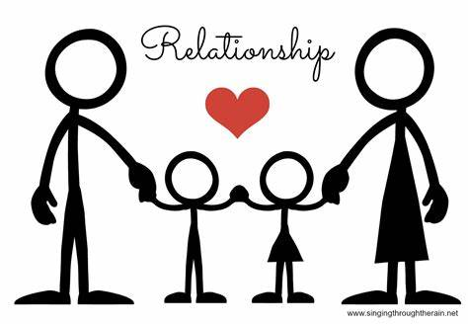
Session 6
Creating Relationships that Build Resiliency

Slide 43

Key Elements to Explore
Initial Meeting
Establishing a trust based relationship
Igniting the “Spark of Hope”
Support Change

Slide 44
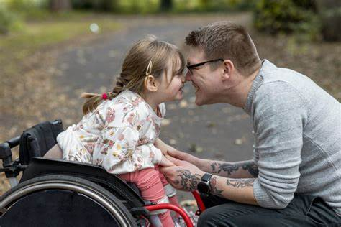
The Initial Meeting
Explain your role
Give your background
Explain concepts of confidentiality
Your Availability
Anything on your mind?
End on a positive note
Setting these things up well on the initial meeting sets a good pace for what is to come. “Sets the stage” for a good relationship for support.

Slide 45

Establishing a Trust Based Relationship
Find their interests
Role Model
Count on YOU
Actively Listen
Use Affirmation

Slide 46

Encourage a Commitment to Change: Ignite the “Spark of Hope”
Identify an area of interest
Create excitement around this!
Find actions the person can take
Look for something to help develop new skills
Use your story!

Slide 47
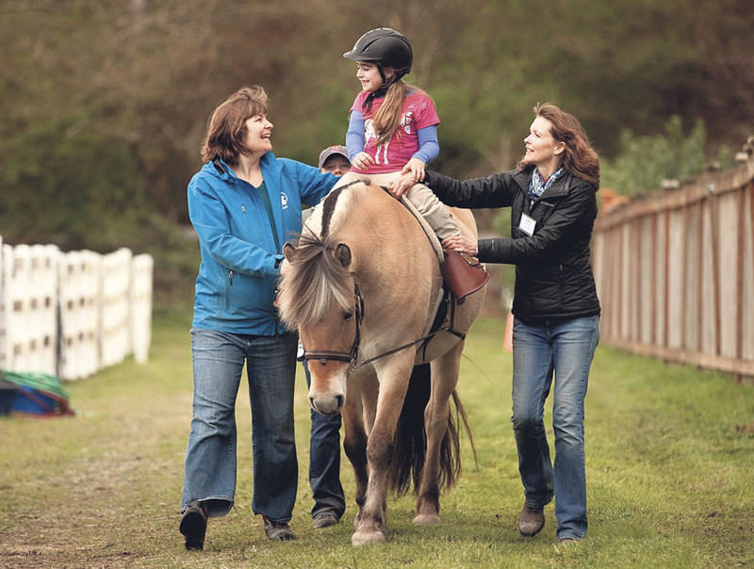
Support Change Actions
Help plan to reach their goals
Clarify roles, responsibilities and expectations
Remind family of the potential benefits
Measure and evaluate progress
Acknowledge and reward!

Slide 48
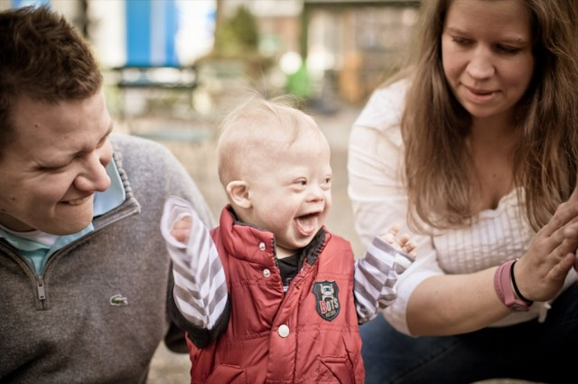
REAL Play: Initial Meeting
Remember Key Steps:
Explain your role
Give your background
Explain confidentiality
Explain your availability
Ask if there’s anything they want to talk about
End on a positive note
Debrief what worked? What to improve?

Slide 49

REAL Play: Ignite the “Spark of Hope”
Remember:
Identify Interests
Create excitement about them
Find actions to take
Look for ways to develop skills
Use your resiliency story
Debrief: What went well? What to improve?

Slide 50
Review Questions: Session 6
What are the five steps in establishing a trust-based relationship?
What would you do to ignite the spark of hope in a parent who does not see any possibility?
What are the six steps to having a successful initial meeting?

Slide 51

Session 7
Effective Listening and the Art of Asking Questions

Slide 52

Effective Listening and Asking Good Questions is an Art!
Why is listening so important and why must we develop the ability to do this well?
Quotes
Difference in listening and effective listening
Asking good questions can help us listen for ways to support families, let’s examine how!

Slide 53

Quotes
“If you listen to a parent long enough, not only will they tell you what is currently going on in their lives, but you will be able to see what strengths exist within their families even if they can’t recognize those strengths themselves.”
When someone truly listens to me, and does not interrupt with judgements, criticisms, stories of their own or even good advice, I feel better and often figure out what I need to do for my family.”

Slide 54
Establishing a Trust Based Relationship
There is a difference in listening and what is called effective listening. Effective listening has to do with knowing what we are listening for and deciphering important relevant information.
In family support, we are basically listening for information that will indicate what a family’s values are, what their culture is, what strengths they have, what their goals are for their families, and finally barriers to reaching their goals. What they believe about themselves and their families comes out in conversation. A family might be able to tell you this information when directly asked, or they may not. You must build a relationship with a family before you will be able to really know about their values, culture, strengths, and barriers but even from little bits of information you can usually find relevant information.
What you are listening for is often what you hear and that is why learning to ask questions is an important part of our training.

Slide 55

Three Ways We Can Make Sure the Questions We Ask Are Helpful
Open ended and honest: Have a discussion around open and close ended questions.
Come from deep attentiveness: Have a discussion on what this means. Examples?
Help a person come to their own conclusions and solutions: Discuss examples found in the following slides.

Slide 56
Questions Should be Open-Ended and Honest
Questions should be open-ended and honest. An open-ended question is a question that requires a full answer using the subject’s own knowledge or feelings. Closed-ended questions are answered in a short or single word answer.
  Examples of open-ended questions:
    How exactly did the argument between the two of you start?
    How can I support you?
    What went well during this meeting? What didn’t go so well?
  Examples of closed-ended questions:
    You feel terrible, today don’t you?
    Do you want me to call the doctor for you?
    That school meeting was ridiculous wasn’t it?

Slide 57
Questions Should Come From Deep Attentiveness
Questions should come from deep attentiveness. Focus on what a person is saying. Try not to be distracted by your thoughts, or your own experiences that may relate to the conversation.
  Tips
    Clarify if you don’t understand, “I think I heard you say that your daughter was on an IEP but isn’t currently?”
    Ask open-ended questions if there are gaps in information, “What happened at school that made them think she no longer needed an IEP?”

Slide 58
Questions Should be Helpful in Allowing A Person to Come to Their Own Conclusions and Solutions
Questions should be helpful in allowing a person to come to their own conclusions and solutions. We want to empower families and build resiliency by supporting them.
  Examples:
    What do you think you should do in this situation?
    When this happened to you before how did you handle it?
    Do you have any information on this kind of thing?

Slide 59

REAL Play
Practice asking good questions
REMEMBER to listen for VALUES, CULTURE, STRENGHTS, GOALS and BARRIERS

Slide 60
Scenario 2
Logan is a 23-year-old man with a diagnosis of Down Syndrome. During High school he was not considered a good candidate for employment due to communication issues. Logan's family looked into several job coaching opportunities and services and Logan was always deemed unemployable. The family tried a day program and Logan felt so sad there. He wants to work and be a part of the community. The family has him involved in some extended learning classes and he participates in swimming. Logan's dad is at home so they go into the community daily. Logan had an opportunity to work with a Community Resource Center. It started well but the program has ended. Logan's case manager is involved and they are working on home modifications to assist with safety in the home. Approval has not been finalized and it has been 7 months since starting this process. Logan likes to go to the movies he wants to drive a car he wants to be a barber. Logan's parents and brother are guardians. Since Logan has had another disappointing experience the family is really not sure where to begin. Trust has been broken and Logan has so much more to offer than just being at home all day. Should the family just give up so he is safe and not disappointed? Logan has been very firm on his dreams but the family is worried he will once again be dropped from a program or there is no provider.

Slide 61
Review Questions: Session 7
What are 3 characteristics of a good question?
When you listen effectively, what are the 5 things you are listening for?

