Slide 1
Family Support Provider
Basic Training
Day 2

Slide 2

Session 8
Using Dissatisfaction to Find Resiliency Goals

Slide 3
How to Help Families Recognize Their Resiliency Goals
May not use the actual word “dissatisfied.” What might they say?
The greater the dissatisfaction, the more likely they will want to change. How can we help them explore their dissatisfaction?
In order to see the possibilities, the person has to see they will be successful. How can we help them develop those thoughts?
What keeps people from changing? How can we identify barriers?
No one makes major changes along. How can we identify their supports?
Dissatisfaction Tool

Slide 4
Dissatisfaction Tool to Set Resiliency Goals
(Example)
1) What are you unhappy with? (I don’t have a job and I want to work)
2) What do you not like about ? (not having a job)
3) What would you rather be doing? (working, feeling productive)
4) What is keeping you from doing that? (transportation, I don’t have any training, I need help filling out an application)
5) Who can support you in obtaining this goal? (Vocational Rehabilitation (Voc. Rehab), Case Manager, family, Family Support Specialist)
6) When do you want to start? (As soon as possible)

Slide 5
Review Questions: Session 8
When a person identifies something they are dissatisfied with, what are 6 things we can help them think through in order to set a goal?
What is the difference between a resiliency goal and a treatment goal?
Give two examples of a resiliency goal.

Slide 6
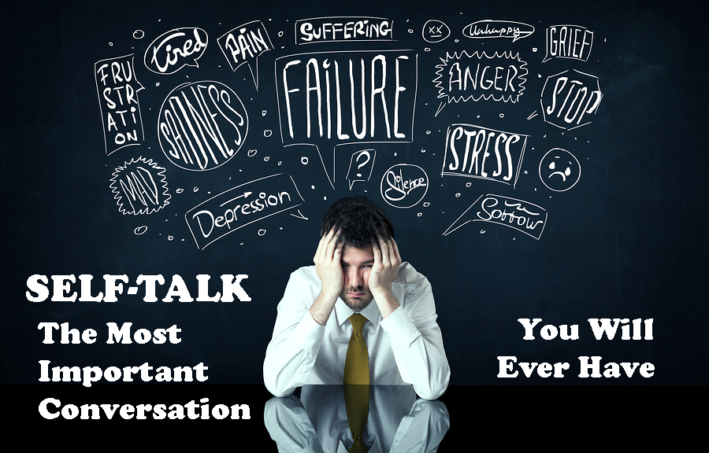
Session 9
Combating Negative Self Talk

Slide 7

What is Negative Self-Talk
Negative self-talk is the negative things we tell ourselves that keep us from obtaining and keeping our goals.

Slide 8

Carol’s Story
What were your thoughts while you listed to Carol’s story?
Which has more power? Other’s comments or your own?
Discuss and revisit

Slide 9

Group Discussion Questions
What are your thoughts and feelings while you listed?
Which has more power? The negative comments or our own self-talk?
What is the progression of negative self-talk?

Slide 10

A Tool to Combat Negative Self-Talk?
CHECK IT!
CHECK IT!
CHANGE IT!

Slide 11

List Five Actions You Have Found Helpful in Catching, Checking and Changing Your Negative Self-Talk
Action One:
Action Two:
Action Three:
Action Four:
Action Five:

Slide 12
Review Questions: Session 9
What is negative self-talk?
What tool would you use to combat negative self-talk?
Where in the 5 stages would you use this tool?

Slide 13

Session 10
Problem Solving With Families

Slide 14

If it Was Easy, We Would Already Be Doing It Right?
Problems prevent us from doing what we want we want to do. Problem behaviors are the things we do to create or sustain the problem.
What is the Key to Problem Solving?
“A problem clearly stated is a problem half solved.”

Slide 15

The Three Keys to Problem Solving
The Key to Problem Solving is:
  The ability to stand outside the problem and to view it with some sense of objectivity.
  The willingness to never make a major decision until you are clear that there are at least two options.
  The awareness that there are always a multiple ways of coming to a solution and “A Problem Clearly Stated is a Problem Half Solved.”

Slide 16

Use the P.I.C.B.A Tool
Problem
Impact
Cost/Benefit
Brainstorm
Actions

Slide 17
PICBA: Helping a Family
Problem – Step 1 – Help the family state the problem as clearly as possible. (Ask the family questions about their current situation and how the current situation is keeping them from doing what they would like to do.)
Impact – Step 2 – Ask what they might be doing that is negatively impacting the situation or helping create the problem.
Cost/Benefits – Step 3 – Ask if the problem is not resolved, what is the cost in the short term? What’s going to happen in the long term? If the problem is resolved, what are some of the short-term benefits? What would be some of the long- term benefits?
Brainstorm – Step 4 – What are 5-7 Possible ways to solve this problem?
Actions - (small steps) - Step 5 – Select the 1-2 best solutions from the above list. What are the actions that you need to take to begin working on the solutions?

Slide 18

PICBA Activity: Helping a Family
Pair up and practice using the tool for a actual problem a family may be experiencing. Please keep it simple.
Debrief and large group discussion

Slide 19

PICBA Activity: Helping Individual
Work as a large group in the interest of time.
If anyone in the group is comfortable sharing a “real life” problem they may be experiencing.

Slide 20
PICBA: Individual Problem
Problem – Step 1 – What is the current situation and what is keeping us from doing what we would like to do?
Impact – Step 2 – How are we negatively impacting the situation or helping to create the problem?
Cost/Benefits – Step 3 –If the problem is not resolved, what is the cost in the short term? What’s going to happen in the long term? If the problem is resolved, what are some of the short-term benefits? What would be some of the long-term benefits?
Brainstorm (big actions) – Step 4 - What are 5-7 possible ways to solving this problem?
**Discuss with the individual the possible pros and cons of each of the above solutions.
Actions (small steps) - Step 5 – Select the 1-2 best solutions from the above list. What are the actions that you need to take to begin working on the solutions?

Slide 21

Review Questions
What are the five basic steps to problem solving with families?
Where in the five stages would you use this tool?

Slide 22

Session 11
Suicide Prevention and Planning for Crisis Situations

Slide 23
Suicide Myths and Facts
Myth: There is nothing that can be done if someone wants to take their own life.
Fact: Suicide is preventable. People who consider suicide don’t necessarily want to die but do want their pain to stop. Getting the person into treatment is the best way to help them.
Myth: People who consider suicide are crazy.
Fact: Most people who attempt suicide have a medical condition or chemical imbalance that puts them at risk for suicide. It can result from prolonged or intense stress. It can result from health conditions like depression, heart disease, or diabetes. It can be a side effect from medications. It can be from changing hormone levels. It can be from alcohol or drug use.
Myth: Talking about suicide will encourage people to do it.
Fact: Research has shown that asking someone in crisis about their intentions and plans does not encourage them to do it. It is important to take any talk about wanting to die seriously. Don’t joke about it. Don’t dare them to do it.
Myth: People who attempt suicide are of weak character.
Fact: Thinking about, planning for, or attempting suicide has nothing to do with one’s character. Good people can experience depression and suicidal thoughts.
Myth: People who talk about wanting to die won’t really do it.
Fact: Talking about wanting to die, not having a reason to live, and being a burden to others are warning signs for suicide. It should be taken seriously.
Myth: People who are suicidal will always be suicidal.
Fact: People who get treatment may never become suicidal ever again. In the short-term, people who do attempt suicide may try repeated attempts. Follow-up care is very important for someone who has attempted suicide.
Myth: Young people are the ones who usually take their own lives.
Fact: Suicide rates are much higher for adults than for youths. The suicide rate is highest for adult men. Their deaths do impact young people. Counseling can often help a family who has experienced a loss due to suicide.

Slide 24
Here’s How to Talk to Someone Who May Be Struggling with Their Behavioral Health
Be direct. Talk openly and matter-of-factly about suicide.
Ask directly about suicide.
Be willing to listen. Allow expressions of feelings. Accept the feelings.
Be non-judgmental. Don’t debate whether suicide is right or wrong, or whether feelings are good or bad. Don’t lecture on the value of life.
Get involved. Become available. Show interest and support.
Don’t dare him or her to do it.
Don’t act shocked. This will put distance between you.
Don’t be sworn to secrecy. Seek support.
DO Offer hope that alternatives are available but do not offer glib reassurance.
Act. Remove means, like weapons or pills.
If unsure - Get help! Follow your agency’s protocol, call 988
Never keep it a secret if someone tells you about a plan to hurt themselves. Call 988 so that you can find out what resources are available in your area, or encourage your loved one to call. Calls are routed to the Lifeline center closest to your area code that can provide you with local resources.

Slide 25

What are the Risk Factors
Risk factors include characteristics or circumstances that indicate an increase in the chance of that person dying by suicide. Risk factors are important to determine as they help alert gatekeepers (friends, family members, health professionals, etc.) of heightened suicide risk.

Slide 26
Risk Factors
Mental health disorders; particularly mood disorders, schizophrenia, anxiety disorders and certain personality disorders
Alcohol and other substance use disorder
Local clusters of suicide
Lack of social support and sense of isolation
Stigma associated with asking for help
Lack of health care, especially mental health and substance use treatment
Cultural and religious beliefs, such as the belief that suicide is a noble resolution of a personal dilemma
Exposure to others who have died by suicide (in real life or via the media and Internet)
Hopelessness

Slide 27

Risk Factors
Impulsive and/or aggressive tendencies
History of trauma or abuse
Major physical illnesses or chronic illnesses
Previous suicide attempt
Family history of suicide
Recent job or financial loss
Recent loss of relationship
Easy access to lethal means

Slide 28

Stages of Change in Building Resiliency
Become familiar with how clinical professionals understand and discuss stages of change is essential to communicating with clinical teams
Stages of Change Model in Building Resiliency presents commonly understood concepts about stages of change in clinical treatment settings.

Slide 29
Protective Factors
Effective clinical care for mental, physical and substance use disorders
Easy access to a variety of clinical interventions
Restricted access to highly lethal means of suicide
Strong connections to family and community support
Support through ongoing medical and behavioral health care relationships
Skills in problem solving, conflict resolution and handling problems in a non-violent way
Cultural and religious beliefs that discourage suicide and support self-preservation
This list comes from SAMSHA’s Suicide Prevention Resource Center document, “Risk and Protective Factors for Suicide.” To view the Examples of Risk and Protective Factors in a Social Ecological Model visit SAMSHA at https://www.samhsa.gov/

Slide 30
What is 988
In July of 2022, 988 became the national three-digit phone number for all mental health, substance use, and suicide crises. 988 calls will be routed to the National Suicide Prevention Lifeline centers in each state, transitioning from the current Lifeline number, 1-800-273-8255. 988 offers rapid access to behavioral health support through connection with trained crisis specialists. While 988 will be available nationally, it is up to each state to ensure crisis services are adequately funded and available to anyone, anywhere, anytime. Missouri's 988 Task Force is developing a 988 plan and exploring long-term funding options.
988 is opening the door to a robust crisis system that can de-escalate mental health crises and connect individuals to the most appropriate care. With 988 as the first component of our system, we hope to see:
A change in the community response to behavioral health crises
A decrease in suicides and other poor mental health outcomes
A reduction in health care spending and use of law enforcement with more cost-effective early intervention

Slide 31
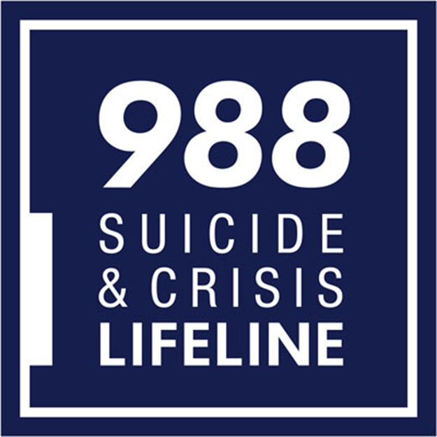
When Should You Call 988?
Anyone in need of crisis support for themselves or someone else should call 988 starting on July 16, 2022. Until that time, help can be found at 1-800-273-8255.
For more information visit the Missouri Department of Mental Health’s Website at www.dmh.mo.gov/behavioral-health/988-suicide-and-crisis-lifeline

Slide 32
Review Questions: Session 11
What is 988?
What are protective factors?
True or False: When someone is suicidal, be direct. Talk openly and matter-of-factly about suicide.

Slide 33

Session 12
Motivational Interviewing for Families

Slide 34

The OARS Model Essential Communication Skills
O.A.R.S. is a skills-based model of interactive techniques adapted for a family-centered approach, using motivational interviewing principles. These skill-based techniques include verbal and non-verbal responses and behaviors. Both verbal and non-verbal techniques need to be adapted to be culturally sensitive and appropriate.

Slide 35

The OARS Model Includes 4 Basic Skills
O = Open-Ended Questions
A = Affirmations
R = Reflective Listening
S = Summarizing

Slide 36

The Purpose of the OARS Model
1) Provide us with a common language when teaching communication skills.
2) Provide us with a “checklist” of skills as we do our on-going skills self-assessment.
3) Provide us with a format to help us be intentional when working with our families.
Using skills intentionally helps us become more efficient and more effective in the work that we do.

Slide 37

The Purpose of a Open Ended Question
The purpose of using open-ended questions is to:
• Establish a safe environment, and build trusting and respectful relationships.
• Explore, clarify and gain an understanding of your family’s world.
• Learn about the family’s past experience, feelings, thoughts, beliefs, and behaviors.
• Gather information – the family does most of the talking.
• Help the family make an informed decision. EXAMPLES – Ask:

Slide 38

The Purpose of Using Affirmation Statement is To:
Build rapport; demonstrate empathy; affirm exploration into the family’s world.
Affirm the family’s past decisions, abilities, and healthy behaviors.
Build a family’s self-efficacy – an ability to believe they can be responsible for their own decisions and their lives.

Slide 39

The Purpose of Reflective Listening is To:
Demonstrate to the family that you are listening and trying to understand their situation.
Offer the family an opportunity to “hear” their own words, feelings and behaviors reflected back to them.
Reflect the family’s thoughts, feelings and behaviors.
Reflect the family’s general experiences and the “in the moment” experience of the visit.

Slide 40

The Purpose of Summarizing
A collective summary—“So let’s go over what we have talked about so far.”
2. A linking summary—“A minute ago you said you wanted to talk to _____. Maybe now we can talk about how you might try .....”
3. A transitional summary—“So you will make an appointment today before you leave and maybe we will see you again soon.”
Summarizing skills keep you and your family on the same page throughout your session. In addition, summarizing the session will help you close your session with the family’s plan of action.

Slide 41
O.A.R.S. +
O.A.R.S. +
R = Roll with Ambivalence
When you sense that signs of an argument are present, stop the conversation and indicate that the intent is not to take sides but that you are seeking understanding of his/her point of view. Argument, confrontation, lectures, and fear tactics lead to the family’s resistance. This can be perceived by the family as judging and typically breeds defensiveness.
Ambivalence is behavior that occurs when two people have their own point of view. Ambivalence occurs when the
professional is moving the family ahead too quickly, or the professional has failed to understand something that is very
important to the family. When ambivalence appears, it is time to do something different.

Slide 42
IF Your Family is Ambivalent, Change Your Strategy. Strive for Collaboration by:
• Asking open-ended questions to clarify.
Can you tell me more about what happens when you try to stop drinking?
• Summarizing what you have heard from the family—Are you hearing correctly?
So it sounds like you are more likely to drink when you encounter someone from your past that you often spent time
drinking with?
• Reflective listening to reframe a family’s statement and offer a positive perspective on what the family has already done.
I know you said you are really frustrated and don’t know what to do. But you are talking with me about it and it seems
like you want to do something different.
• Reflective listening to turn the question back to the family. The family has the solution.
As we talk about changing your social community it seems like there might be more going on ... what am I missing?
D = Develop Discrepancy (Disconnect)
The focus of MI is on developing discrepancy (disconnect) between the family’s behavior and broader goals and values.
Most often people are motivated to change when they hear it from themselves rather than from someone else. Guide the
discussion to allow the family to share personal values/beliefs regarding what is important for them and their future goals.
Listen closely for statements about life, health, financial status, living situation and any other personal considerations.

Slide 43
Review Questions: Session 12
What Does OARS stand for?
When the family you are working with is ambivalent, what do you do?
What is motivational interviewing?

Slide 44

Session 13
Clarifying and Establishing Boundaries

Slide 45

Boundaries What Are They?
Boundaries can seem ambiguous. A few things to remember:
They are unseen lines you won’t cross
Physical and emotional distances that may be hard to define
Parameters that make you unique
Self-imposed and self-defined
Boundaries are where you end and another person begins

Slide 46

Discussion: Why Be Concerned About Boundaries?
What could happen if boundaries didn’t exist?
Do you think Family Support Providers should follow boundaries and codes of conduct and why?
Can you describe the difference in boundaries between friends and colleagues?

Slide 47

Discussion: Why Be Concerned About Boundaries?
What are boundary violations?
How do they happen and how can they be harmful?
Essentially, what do boundaries protect for both FSP and families?

Slide 48

Four Common Elements of Boundary Violations
Secrecy
Role reversal
Double bind
Indulgence of professional privilege
The following is a discussion about all 4 of the following slides

Slide 49

Discussion: Secrecy and Role Reversal
Give example of a secrecy violation
Describe and give examples of role reversal

Slide 50

Discussion: Double Bind and Indulgence of Professional Privilege
Describe what happens in double bind and give an example
Describe indulgence of professional

Slide 51
Some Warning Sign Boundaries Are Becoming Blurred:
Choosing sides
Making exceptions
Keeping secrets
Giving or receiving gifts
Borrowing or lending money
Feeling like you’re the only one who cares about the person
Feeling you’re the only one able to help
Feeling responsible for their progress
“Owning” their success/failure
Confiding personal or professional troubles
Providing services you’re not qualified to, i.e., therapy

Slide 52

Discussion: How to Make Good Decisions
What questions can you ask yourself about your interactions?
What are some ways you can troubleshoot yourself and your work?
If you are worried about your boundaries or of those who you serve, where can you turn for help?
Key takeaway: Good boundaries establish trust!

Slide 53
Review Questions: Session 13
What are 4 common elements of boundary violations?

Slide 54

Session 14
Family Support Providers Code of Ethics

Slide 55
FSP Ethics Code
Note: All of the principles and ethical standards have been identified with a dual range of seriousness (except for a few that have only one option available). The intention of this guide is to assist the investigators and the Ethics Committee in applying an ‘indication’ of seriousness to the hearing panels so that a more standardized method of sanction can be used when applied. All agree that there may be “extenuating circumstances” that differentiate seriousness for violations, i.e., some violations may be a result of oversight or carelessness, when others are clearly intentional and without remorse. With any “SUBSTANTIATED VIOLATION”, it is now an expectation that there will be an attached level of seriousness being suggested by the Investigators and the Committee. Those levels are;
S = Serious
VS = Very Serious
ES = Extremely Serious

Slide 56
FSP Ethics Code
Family Support Providers (FSP) will maintain high standards of professional conduct and ethics as embodied in the statements below:
FSP will be guided by the principles of self-determination for all. The primary responsibility of family support is to help individuals achieve their own needs, wants and goals. (S)
FSP will maintain high standards of personal conduct, modeling accountable relationships, and fostering wellness and self-care along with their own resiliency. (VS/ES)
FSP will share with family support providers and colleagues their resiliency stories and will likewise be able to identify and describe the supports that promote their own resiliency. (S)
FSP will respect the privacy and confidentiality of private information shared by individuals utilizing family support services or other related professional services at the organization. Unless necessary for supervision, required by law, or otherwise consented to by the individual personally, no confidential information will be revealed to anyone. (S/VS/ES)
FSP will at all times, respect the rights and dignity of those they serve. (S/VS)

Slide 57
FSP Ethics Code
FSP will keep current with emerging knowledge relevant to resiliency and share this knowledge with their colleagues and those they serve. (S)
FSP will never intimidate, threaten, harass, use undue influence, physical force or verbal abuse, or make unwarranted promises of benefits to the individuals they serve. (VS/ES)
FSP will not engage in romantic or sexual intimacies with the people utilizing family support services in the organization where the FSP is providing services. FSP will not engage in romantic or sexual intimacies with an individual the FSP has provided family support services to for a period of 5 years after the family support relationship has been terminated. FSP does not provide family support services to anyone with whom they've had romantic or sexual intimacies in the past. (ES)
An FSP shall not initiate or cultivate a personal relationship once the professional family support relationship has ended with a former family or family member for a period of five years. This may include, but is not limited to: familial, social, romantic/sexual, financial, business or other types of close personal relationships with former families or family members. (VS/ES)
FSP will not practice, condone, facilitate or collaborate in any form of discrimination on the basis of ethnicity, race, gender, sexual orientation, age, religion, national origin, marital status, political belief, mental or physical disability, or any other preference or personal characteristic, condition or state. (S/VS)

Slide 58
FSP Ethics Code
FSP will advocate for those they serve that they may make their own decisions in all matters, including when dealing with other professionals. (S/VS)
FSP will advocate for the full integration of individuals into the communities of their choice and will promote the inherent value of these individuals to those communities. FSP will be directed by the knowledge that all individuals have the right to live in the least restrictive and least intrusive environment. (S/VS)
FSP will strive to avoid dual relationships or commitments that conflict with the interests of those they serve. When a dual relationship or conflict can’t be avoided, the FSP informs a supervisor of the relationship or conflict and strives to ensure the individual is not exploited in any way. (ES)
FSP will not exchange gifts of significant monetary value with those they serve. (S/VS/ES)
FSP will take responsibility for maintaining the integrity and quality of job performance. This includes using work time to the advantage of the families they serve and always giving the best effort on the job. (S/VS)

Slide 59
FSP Ethics Code
FSP will strive through words and actions to create a professional atmosphere in the work environment. FSP will use people first language and avoid stigmatizing language. FSP will not use derogatory language in their communications, whether written or verbal. FSP will avoid negative criticism of colleagues. (VS/ES)
FSP will fairly and accurately represent themselves and their capabilities to the families and the community. (S/VS)
FSP will maintain a safe and healthy work environment. (S/VS)
FSP will provide services to meet the identified needs of the families and avoid providing services that are unnecessary or not capable of producing the desired effect. (VS/ES)
FSP will not use illegal substances under any circumstance. FSP will not use a prescribed medication in a non-prescribed way and will only use over the counter medication for its intended use. (ES)
FSP will not use relationships with individuals utilizing family support services for financial gain or put the individual at risk of exploitation or harm. (ES)

Slide 60
Review Questions: Session 14
The FSP Ethics Code test questions come directly from one of the 20 codes listed previously. As a FSP it is your responsibility to know the Code of Ethics. If there is a code you would like clarification on, please ask your instructor at this time.

